Slide 1

Welcome to our presentation

Slide 2

Team members
Most.Mili Akter
Id:222-15-6078
Noman Al Badhon
Id:222-15-6365
Fahim Muntasir Khan
Id:222-15-6105
Noor-E-Jannat Tasfi
Id:222-15-6320

Slide 3


Problem 01
Problem Discussion:
Read an integer N and compute all its divisors.
Input:
The input file contains an integer value.
Output:
Write all positive divisors of N, one value per line.

Slide 4
Problem 01
Example:
Input Sample | Output Sample
6 | 1 2 3 6

Slide 5
Problem 01
Logic discussion:
At first we have to use a loop and then we have to apply a condition to determine the divisors of a number.
The condition to determine the divisors of a number are given billow:
(N%i==0)

Slide 6

Problem 01
Code:
#include<stdio.h>
int main()
{
int N,i;
scanf("%d",&N);
for(i=1;i<=N;i++)
{
if(N%i==0)
{
printf("%d\n",i);
}
}
return 0;
}
Header file
Main Function
Variable type
Variable
Input
Loop
Condition
Output
End of Proggrame

Slide 7

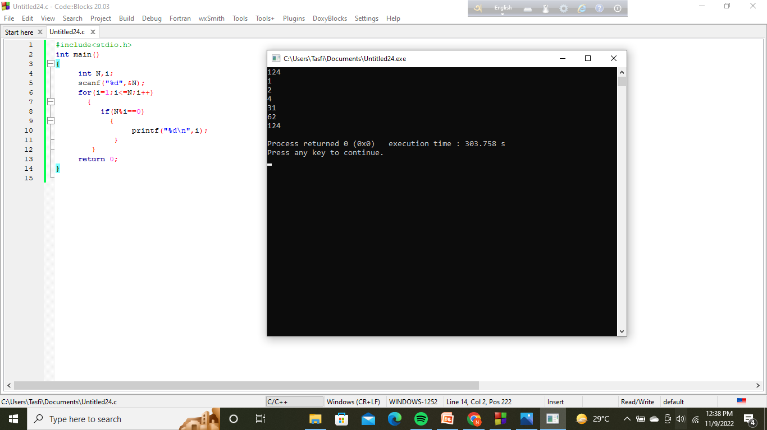
Problem 01
Ouput:

Slide 8

Problem 02
Problem Discussion:
Make a program that reads five integer values. Count how many of these values are even, odd, positive and negative. Print these information like following example.
Input
The input will be 5 integer values.
Output
Print a message like the following example with all letters in lowercase, indicating how many of these values ​​are even, odd, positive and negative.

Slide 9
Problem 02
Example:
Input Sample | Output Sample
-5 0 1 4 -8 | 3 valor(es) par(es) 2 valor(es) impar(es) 2 valor(es) positivo(s) 2 valor(es) negativo(s)

Slide 10



Problem 02
Logic Discussion:
At first we have to use a loop to read that 5 numbers repeatedly.
Next we need 4 logic.The logics are given billow:
1.For even number:
(Number%2==0)
2.For odd number:
(Number%2!=0)
3.For positive number:
(Number>0)
4.For negetive number:
(Number<0)

Slide 11

Problem 02
Code:
#include<stdio.h>
int main()
{
int i,num,even=0,odd=0,positive=0,negative=0;
for(i=1;i<=5;i++)
{
scanf("%d",&num);
if(num%2==0)
{
even++;
}
if(num%2!=0)
{
odd++;
}

Slide 12
Problem 02
Code:
if(0<num)
{
positive++;
}
if(0>num)
{
negative++;
}
}
printf("%d valor(es) par(es)\n",even);
printf("%d valor(es) impar(es)\n",odd);
printf("%d valor(es) positivo(s)\n",positive);
printf("%d valor(es) negativo(s)\n",negative);
return 0;
}

Slide 13


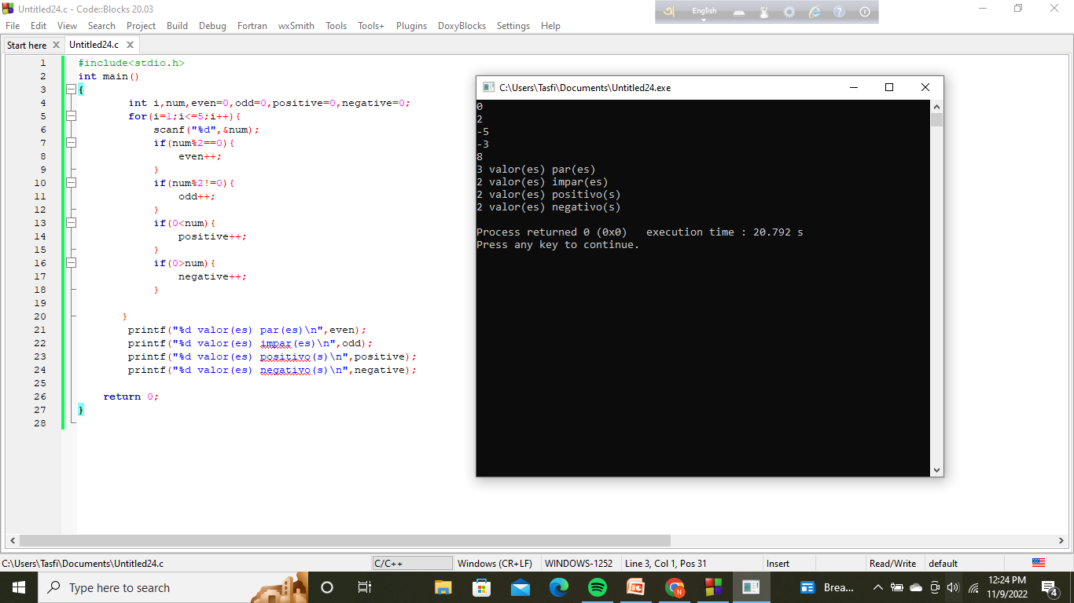
Problem 02
Out Put:

Slide 14



That’s All Every one
Thanks all to give us an oportunity to present us.Now if any one have any questions,you can ask us.

Slide 15


